Slide 1
INTEGRATING PRESERVATION FUNCTIONS INTO THE WEB SERVER
Joan A. Smith
OLD DOMINION UNIVERSITY
August 2008
Presented by: Miranda Smith
11/29/2017

Slide 2
Research Approach
Counting problem
Representation problem
Using web server for web preservation

Slide 3
Counting problem
How do you get all of a website’s resources?
Search engine coverage
Sitemap coverage

Slide 4
Crawler Behavior experiment
30 directory wide websites
Pages deleted daily over 90 day period
Website breadth impact on crawler behavoir

Slide 5
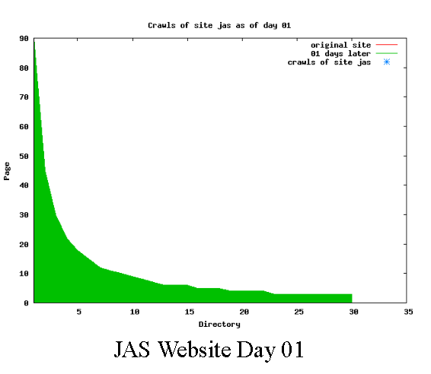
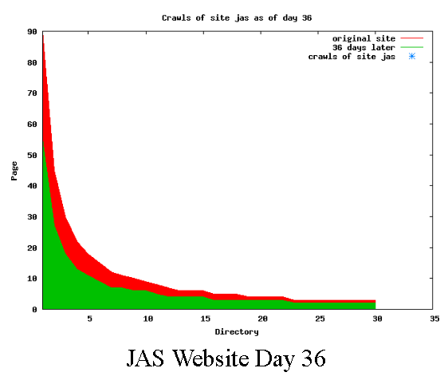
Steady deletion of pages

Slide 6
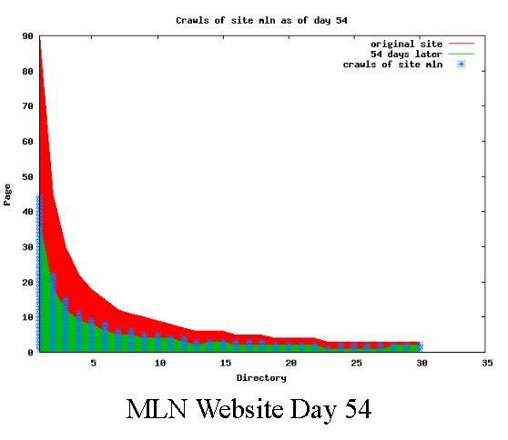
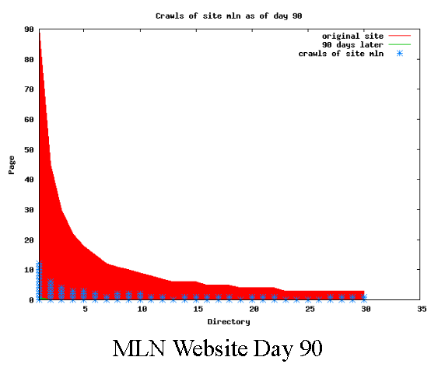
Crawlers will request deleted pages

Slide 7
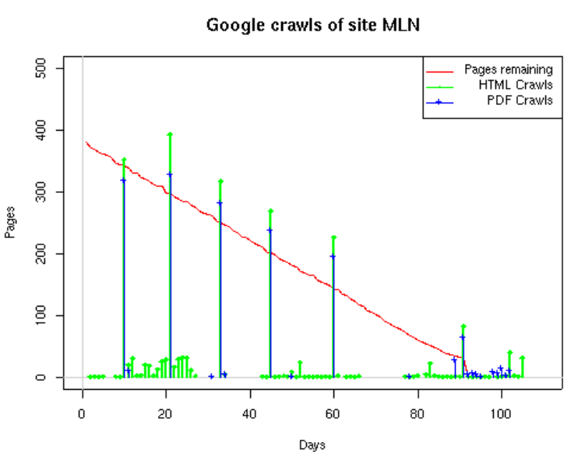
HTML better candidate for restoration
Toe Dip pattern
Crawlers show preference for HTML resources
Images rarely crawled
Breadth did not impact search engine patterns

Slide 8
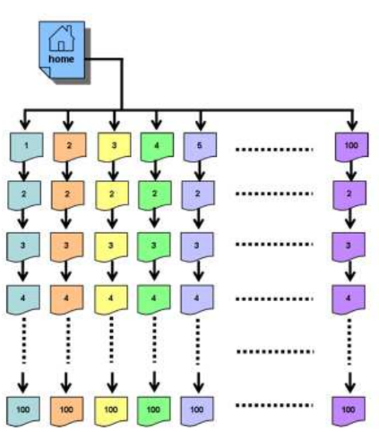
Does depth affect crawler behavior?
Deep website experiment
100 directories wide 100 directories deep
2 Breadcrumb websites
.com & .edu
2 Buffet websites
.com & .edu

Slide 9
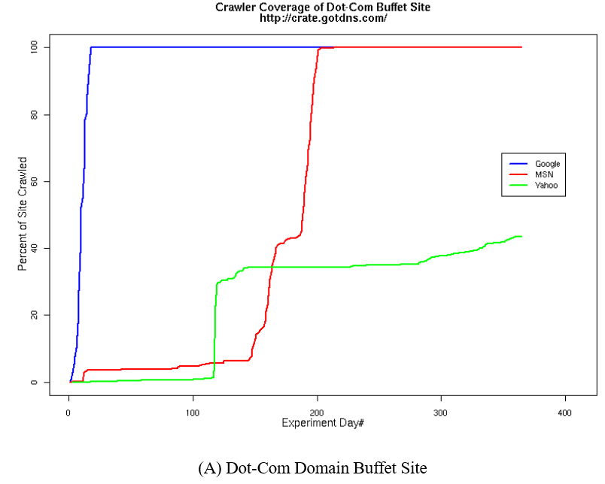
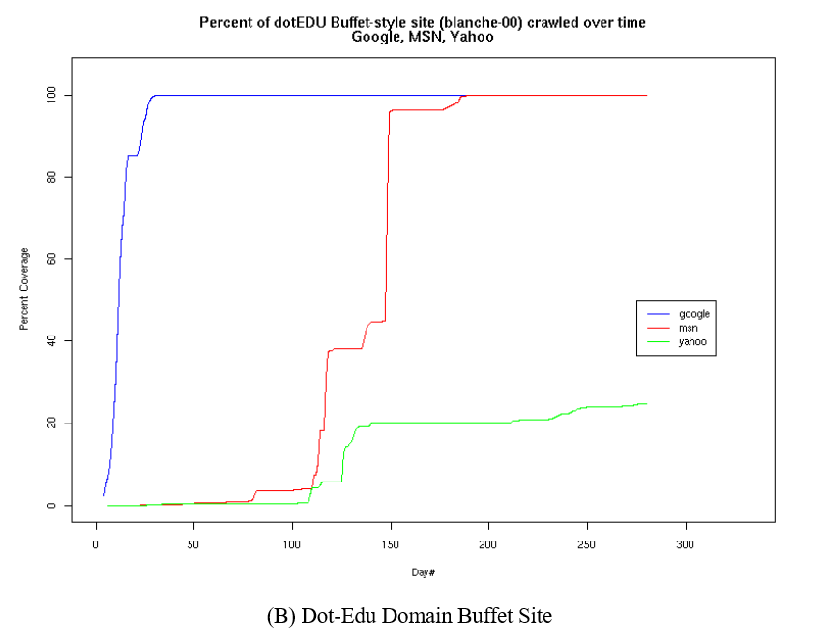
Buffet Coverage

Slide 10
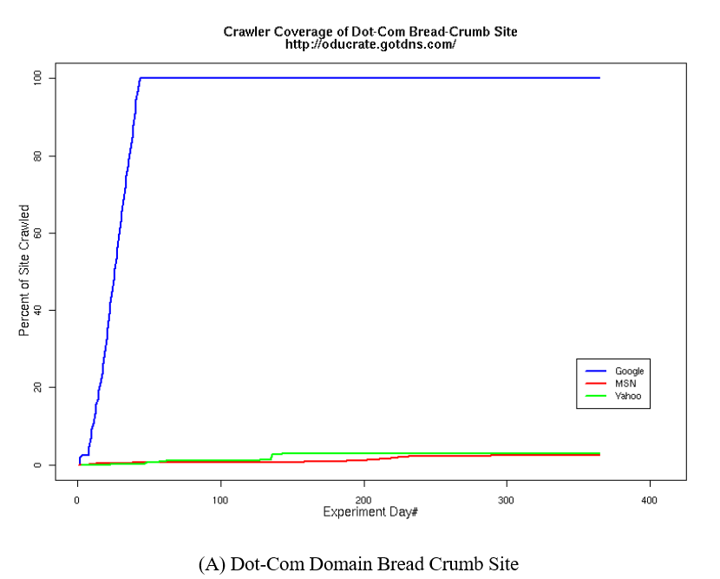
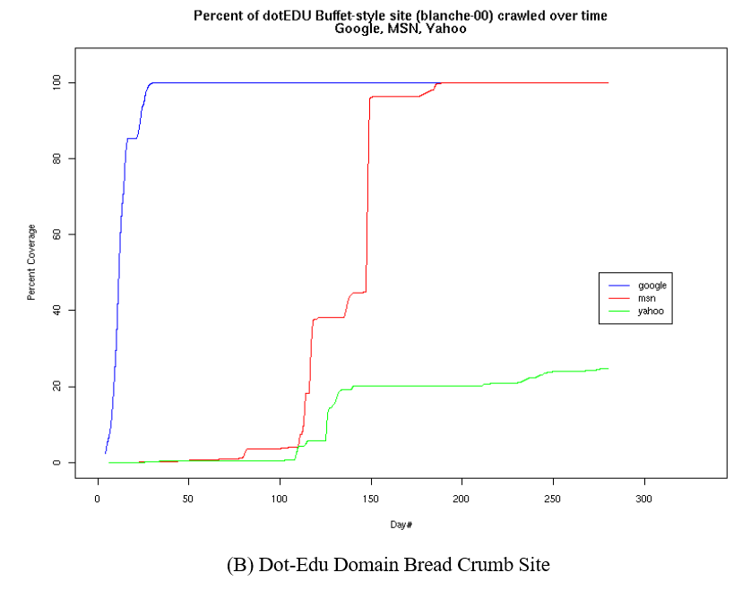
Bread Crumb coverage

Slide 11
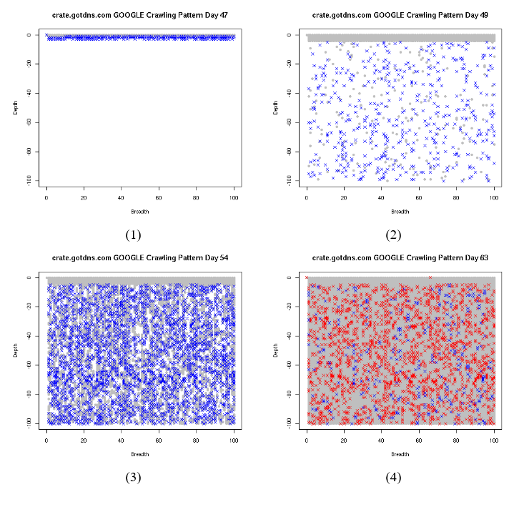
Buffet site

Slide 12
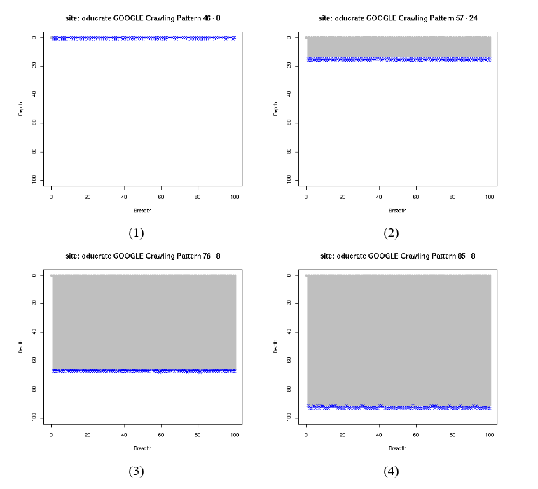
Breadcrumb site

Slide 13
Cooperating with Crawlers
The easier the content is to find the easier it is to archive
Wide better than deep
High level of indexing preferred (buffet)

Slide 14
Sitemap for resource detection
Race condition
Automatic sitemap creation tools only able to access things a web crawler can or they imposes artificial limits

Slide 15
Sitemap
Site map creation best done through combination of
self-crawls
Unlinked pages
Logs
Will get dynamically created content
Will have deleted files
File system map
Backup files
Old unused files
Test files

Slide 16
Representation problem
How do you get enough information about the resource to be able to represent it later when it may be deprecated?
Extract metadata
HTTP only provides enough metadata to interpret today, not future use

Slide 17
Practical to include metadata utilities in server?
Utilities tested
Price
Operating System
Invocation Method
Ease of Installation
Performance under load for MODOAI Plugin for Apache
able to provide 90% of the responses to regular web requests within 16 milliseconds

Slide 18
CRATE
When you request a resource from a web server you can also get the metadata usually missing from the HTTP response
Counting Problem
Sitemap must exist
Must contain all valid accessible site resources
Representation problem
Metadata rich
XML tagged, most likely to be preserved
Automated through MODOAI module
Metadata extraction plugins chosen by web master

Slide 19
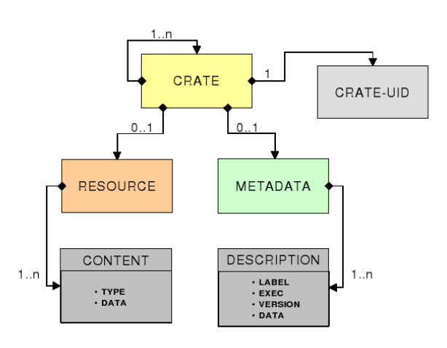
CRATE
No minimum metadata requirement
Easier for non expert to use
Metadata undifferentiated
Flexible for large variety of metadata content

Slide 20
MODOAI implementing CRATE
Apache web server module to expose metadata
redesigned to accommodate CRATE
Recreated around plugin architecture
Data centric approach to preserving metadata
Best effort metadata at dissemination
Instead of strict validation during archivist collection

Slide 21
Contributions
Web crawler behavior
Prefer wide and buffet style sites
Compared logs, crawls, file system traversal
Sitemaps best created through combination
CRATE model
“Pretty good” preservation
Realistic and achievable
No formal relationship between archivist and webmaster
Implemented CRATE in MODOAI Apache module

